Slide 1
ECE 551 Digital Design And Synthesis
Spring ‘19
Digital Circuit Implementations:
Standard Cell
FPGA
Custom Logic

Slide 2
Administrative Matters
Project Demos (all team members should be present)
Weds May 1st 1:00PM till evening B555 (1.5% extra)
Thurs May 2nd 1:00PM till evening B555 (0.75% extra)
Fri May 3rd 1:00PM till evening B555
Final Monday May 6th, 2:45PM Room ???
Comprehensive with focus on Lecture 6 – 12
Can have a 8.5x11 cheatsheet
Prior exam will be posted (and reviewed during last discussion section)

Slide 3
Functional & Synthesized…Now What?
After synthesis, implement as hardware
FPGAs
Standard cells
Custom logic
Choose implementation based on cost and performance requirements

Slide 4
FPGAs
Field Programmable Gate Array
Temporary (SRAM based)
Permanent (Flash) not as common
Pros
Allow for very complex implementations
Generally reuseable (upgrades/bugfixes/prototype)
Low non-recurring engineering costs (NREs)
Cons
Expensive per-unit (10s-100s of $)
Slower than gates
Need support circuits (configuration loading)
Higher power consumption than ASIC.
Not as robust (mission critical operations)

Slide 5
Programming an FPGA
Most designs based on SRAM
Writing to the SRAM “configures” device
Different circuits implemented based on values
Q
Q
READ or WRITE
DATA

Slide 6
Configurable Routing Elements
Programmable connection
Programmable bypass
P
Routing
Resource #1
Routing
Resource #2
OUT
DFF
SIGNAL
P

Slide 7
Logic Elements
Look-Up Table (LUT)
Essentially a very small memory
Most common size is 4-input LUT (shown is 3-input)
P1
0
P2
1
P3
2
P4
3
OUT
P5
4
P6
5
P7
6
P8
7
a
b
c

Slide 8
Logic Elements
Look-Up Table (LUT)
OUT = a XOR b XOR c
abc | OUT
000 | 0
001 | 1
010 | 0
011 | 1
100 | 0
101 | 1
110 | 0
111 | 1
0
0
1
1
0
2
1
3
OUT
0
4
1
5
0
6
1
7
a
b
c

Slide 9
Logic Elements
Look-Up Table (LUT)
OUT = ab + ac + bc
abc | OUT
000 | 1
001 | 0
010 | 1
011 | 1
100 | 1
101 | 1
110 | 0
111 | 1
1
0
0
1
1
2
1
3
OUT
1
4
1
5
0
6
1
7
a
b
c

Slide 10
Logic Elements
Look-Up Table (LUT)
Extremely flexible in implementing logic
Larger and slower than just using gates
P1
0
P2
1
P3
2
P4
3
OUT
P5
4
P6
5
P7
6
P8
7
a
b
c

Slide 11
FPGA Logic Structure
“Cell” or “logic block”:
1 or more LUTs (generally 4-input)
At least one D flip-flop
Possibly fast carry logic
Connect several logic blocks to form circuit
I1 I2 I3 I4
Cout
Cin
carry logic
DFF
4-LUT
OUT

Slide 12
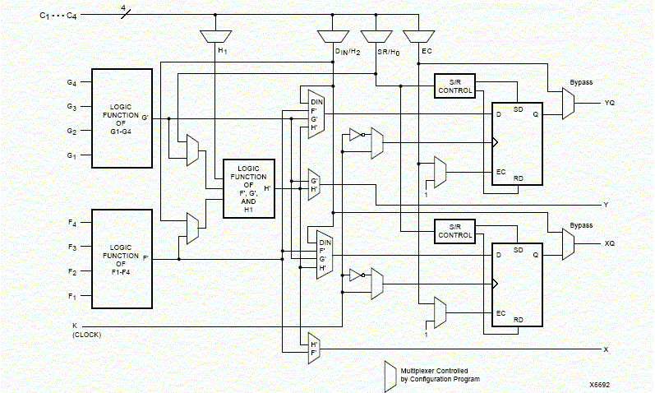
Xilinx 4000 Combinational Logic Block

Slide 13
Xilinx 4000 FPGA
Really much more than 4 CLB’s and 9 configurable routing channels but this gives an idea of the structure

Slide 14
FPGAs
Allow for complex implementations
Generally reuseable (upgrades/bugfixes/prototype)
Low non-recurring engineering costs (NREs)
Expensive per-unit (10s-100s of $)
Slower than gates (Programming points)
Newer FPGAs often incorporate memories, multipliers, peripherals, and even processors all on the same chip

Slide 15
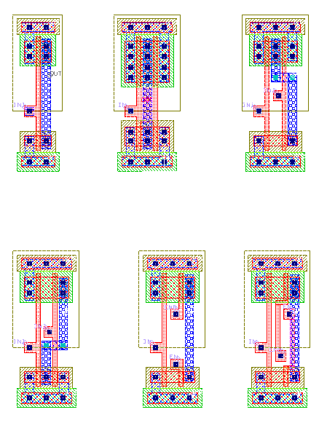
Standard Cells
Gates and other small structures
Can also use macroblocks
Groups of pre-optimized cells
Larger custom-layout structures
More efficient when possible
From: http://www.zuraleff.com/layout

Slide 16
Standard Cell Layouts
Gate, flip-flop, 1-bit adder, …
…
Adjustable Spacing
Metal interconnect placed in channels between cells
Megacells

Slide 17
Standard Cells
Cheap per-unit pricing ($0.50-$10s)
Fast compared to FPGAs
High NREs (design time, mask fabrication...)
$150K-$10M
Cost of a respin is very high in time & $$
Only makes sense for
Large quantities and/or
Critical operations

Slide 18
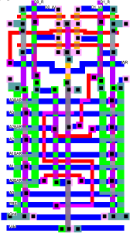
Custom Logic
Manual layout
Very high NREs
Huge design time!
Design changes painful.
Human is still better than the CAD tool at tight layout.
There exists a compromise between standard cell APR and full custom. These datapath synthesis tools do APR on a bitslice basis exploiting symmetry in the netlist.

Slide 19
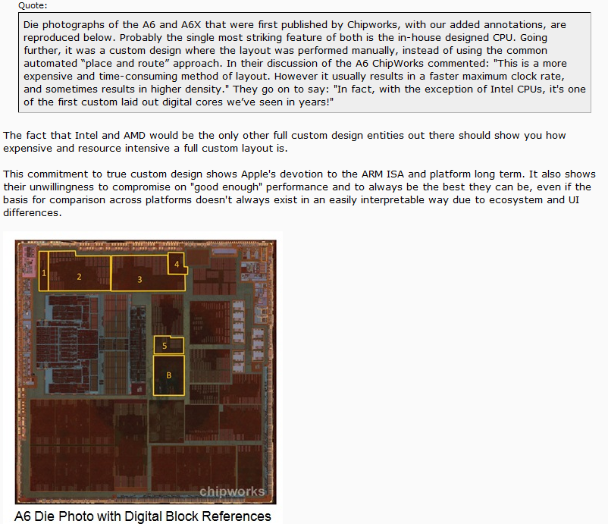
Apple A6 Utilizes Full Custom Design

Slide 20
Hardware Implementations
There is no one “best” method
Tradeoffs between cost and speed
Design complexity matters, too
Standard cells are getting more expensive…
FPGAs are getting faster and bigger…
This will affect future design choices
For a given design, current best choice may not == future best choice!
Another choice to implement your digital design might be a programmable μController with off the shelf support hardware

Slide 21
Tech Mapping: Std. Cells
Example boolean equation:
z = a b c + c d + e
Example cell library:
2-input NAND, INV
Been there…Done that…
This is what we are doing with our designs when synthesizing to the 35nm tsmc library
Resulting Tech Mapped Circuit:
a
c
b
z
e
c
d

Slide 22
Tech Mapping: FPGAs
Need to know building blocks of the FPGA
LUT size (if uses LUTs)
Any special resources (Multipliers, RAMs)
Tech mapping then implements your netlist in terms of those building blocks

Slide 23
Tech Mapping: FPGAs
Example boolean equation:
z = a b c + c d + e
Example basic block:
4-input LUT
Resulting tech-mapped circuit:
a
LUT #1
c
b
z
e
c
d
LUT #2

Slide 24
Tech Mapping: FPGAs
Example boolean equation:
z = a b c + c d + e
Example basic block:
4-input LUT
Resulting tech-mapped circuit:
a
a b c
LUT #1
c
b
y
y + c d + e
e
LUT #2
c
z
d

Slide 25
Placement
Standard Cells:
Choosing a row for each cell
Choosing a location within the row for each cell
Cost function based
Minimize ratsnest (interconnection)
CTS will have priority in placing clock buffers
FPGAs:
Choosing which physical LUTs implement each netlist LUTs

Slide 26
Partitioning & Floorplanning (can be common to both StdCell and FPGA)
Sometimes you have BIG circuits
Makes placement take a long time
Yields poor results (too large a solution space)
Use partitioning and floorplanning
Partitioning: Divide netlist into partitions
Floorplanning: Assign partitions to chip regions
Place regions separately
Benefit: Small problems are easier to solve well than large ones
26

Slide 27
Partitioning Example
H
A
K
D
F
B
I
E
C
L
G
J
How might we choose to form 3 partitions?
27

Slide 28
Partitioning Example - Bad
H
A
K
D
F
B
I
E
C
L
G
J

Slide 29
Partitioning
We want to try to make our partitions as independent as possible.
Independent = fewer outside connections
Why?
Want to keep wires short
Try to place partitions adjacent to the partitions they interconnect with
If we have a lot of interconnections, this may not be easy/possible

Slide 30
Partitioning Example - Bad
H
A
K
D
F
B
I
E
C
L
G
J

Slide 31
Partitioning Example - Better
H
A
K
D
F
B
I
E
C
L
G
J

Slide 32
Floorplanning
OK, so we’ve divided our problem up into partitions
Now, figure out where partitions should be placed relative to one another
Assign partitions to regions of the silicon / FPGA
Try to avoid long wires between partitions
Don’t want to have to route wires through too many other partitions
Wastes area in those partitions
32

Slide 33
Floorplanning Example
1
3
6
8
4
2
7
5
9

Slide 34
Floorplanning Example
Try to arrange partitions to minimize cross-partition routing
1
4
6
2
5
3
8
9
7
Eat your heart out, Sudoku.

Slide 35
Routing
Have locations for all the cells/LUTs in the netlist
Now need to connect them together to actually make the circuit
Different techniques for std. cell vs. FPGA
Divided into:
Global
Detailed (local)

Slide 36
Global Routing
Find a rough path for each net
Figure out what areas a signal passes through

Slide 37
Detailed Routing: Std. Cells
Connect the cells within the global regions
Goal: minimize channel width
1 2 2 4 4 0 3 0 4
Channel Width
2 4 4 3 0 0 3 3 1

Slide 38
Detailed Routing: FPGAs
Assign signals in netlist to:
Wires
Switchbox points
Fixed set of available resources
Can’t “widen” routing channels
Goal: Reduce congestion
Congestion is the ratio of signals:wires
By keeping areas “open”, more likely to be able to route later signals

Slide 39
Detailed Routing: FPGAs
Goal: Reduce congestion

Slide 40
Detailed Routing: FPGAs
Goal: Reduce congestion

Slide 41
Detailed Routing: FPGAs
Frequently start with an “idealized” routing
Signals can share wires
Repeatedly “rip up” and reroute
One or more nets (signals)
Stop when no wires are shared

Slide 42
Conclusion
Synthesis isn’t the end of the process!
Many steps after it
Choose target implementation
Examine cost/performance tradeoffs
Use CAD tools to implement synthesized circuit on FPGA or std. cells
Place & Route
Generate bitstream or layout masks
See ECE556 for more details on CAD algorithms

